Slide 1
Lloyd Sirmons – Director www.setrc.us – 888.738.7210

Slide 2
On August 20, 2010, Georgia Partnership for TeleHealth (GPT) was awarded a HRSA grant from the Office for the Advancement of TeleHealth: Southeastern TeleHealth Resource Center.
Grant Re-Awarded 2013 & 2016 (Grant #: G22RH30350)

Slide 4
Proud partner of the
National Consortium of Telehealth Resource Centers

Slide 5
SETRC provides an applied approach to telehealth education and technical assistance services in order to streamline implementation and better utilize telehealth applications and technology in the region.
Workgroups
Provide insight and direction regarding the advancement of telehealth and encourage collaboration among existing telehealth networks and programs.
Education
Online education through the National School of Applied Telehealth (www.nsat.us)
Awareness
Present and Exhibit at State, Regional & National Events & Meetings

Slide 6
SETRC Advisory Committee
Dr. Anne Burdick – FL – U of M
Mike Smith – FL – FSU
Ron Sparks – AL
Dr. Eric Wallace – AL - UAB
Jeff Robbins – GA – Tift Regional
Jill Davis – GA – Collaborative Telehealth Consulting
Kathy Schwarting – SC – Palmetto Care Conn
Dr. Katie Cristaldi – SC Center of Excellence

Slide 7
www.nsat.us
NSAT is the education arm of the SETRC and delivers
standardized, accredited, and affordable telehealth instruction.
The online Telemedicine / Telehealth Certification courses instruct on the essentials of telehealth and prepare individuals to become valuable members of a telehealth team. A completion certificate with 0.3 CEU/3 credit hours for this course will be awarded when all Learning Outcomes Conditions have been met.
As an IACET Authorized Provider, HomeTown Health University (NSAT) offers continuing education units (CEUs) for its programs that qualify under IACET guidelines (www.iacet.org)

Slide 8
NSAT TeleHealth Courses www.nsat.us
Certified Telemedicine Presenter Course
designed so that its graduates will gain insights and skills in order to correctly and confidently present patients during virtual encounters with healthcare providers and a variety of specialists.
Certified Telehealth Coordinator Course
designed so that its graduates will gain insights and skills to successfully implement, coordinate, and manage a telehealth program.
Certified Telehealth Liaison Course
designed so that its graduates will gain insights and confidence to successfully serve as a leader, promoter, and marketer in the telehealth industry.

Slide 9
Large and small hospitals
Private physician offices
Skilled Nursing Facilities (SNFs)
School Based Health Centers
Mental Health Centers
Correctional Institutes
Colleges/Universities
Ambulances
Why Telehealth?

Slide 10
Increased Access to Quality Care
Enhanced support to Patients and Families
Increased Access to Information
Increased Access to Training
Cost Savings
Why Telehealth?

Slide 12
In Rural America…….
Unintentional injury deaths are approximately 50 percent higher in rural areas than in urban areas, partly due to greater risk of death from motor vehicle crashes and opioid overdoses.
In general, residents of rural areas in the United States tend to be older and sicker than their urban counterparts.
Children in rural areas also face challenges. A recent
CDC study finds that children in rural areas with mental,
behavioral, and developmental disorders face more
community and family challenges than children in urban
areas with the same disorders.
https://www.cdc.gov/ruralhealth/ruralhealthbasics.html

Slide 13
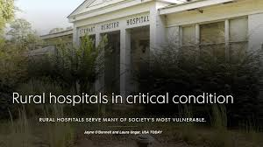
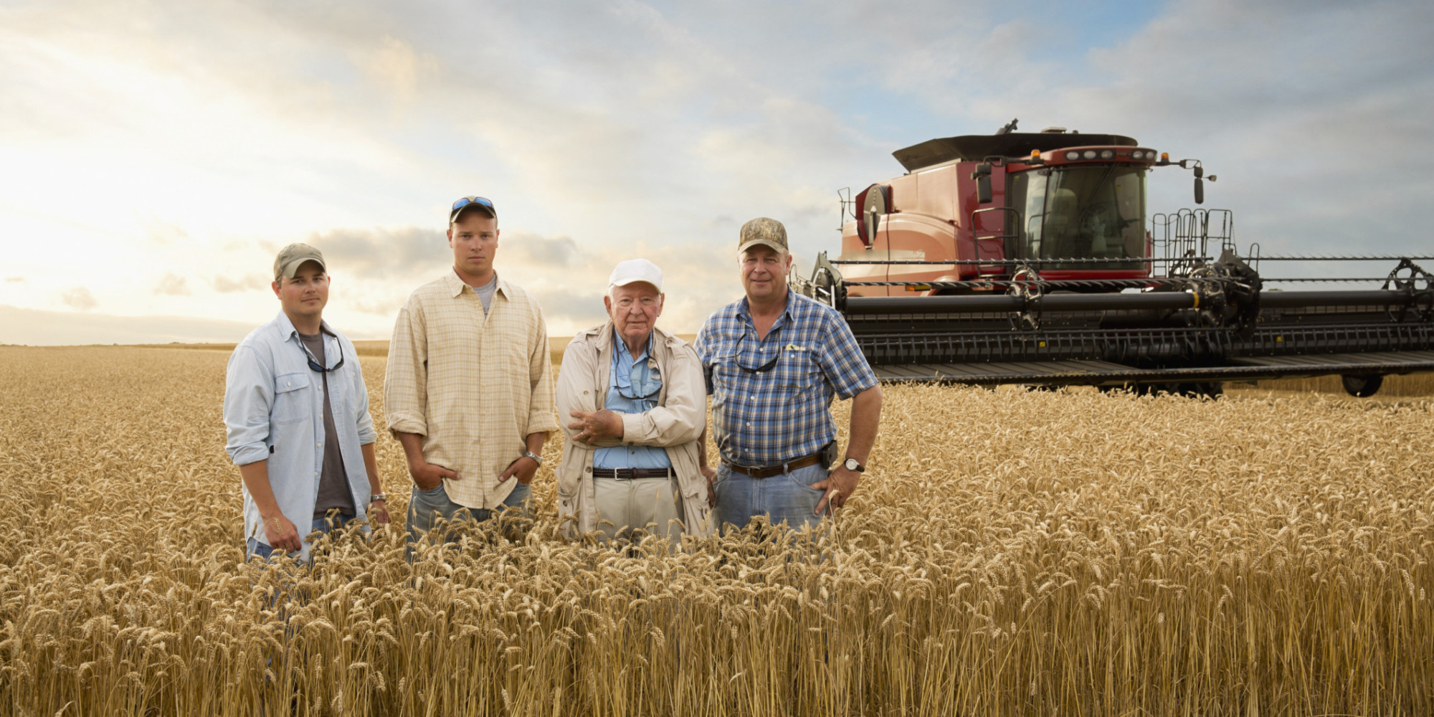
Healthcare in America: A Snapshot of the Good, the Bad, the Lovely!

Slide 14
Healthcare in America: the Good, the Bad, and the Lovely
The BAD:
The US will face a shortage of up to 104,900 physicians by 2030, according to a new study commissioned by the American Association of Medical Colleges. In the March 2017 study, it was found that the numbers of new primary care physicians and other medical specialists are not keeping pace with the demands of a growing and aging population. This paints a grim picture of future healthcare in America but especially for rural America.
The GOOD:
Telemedicine is a viable tool to address some of today’s healthcare delivery issues. Telemedicine technologies are being utilized across the globe to address shortages in the clinical workforce, improve access to care, provide more patient and family centered care, increase efficiencies in practice, and enhance the quality of care.
The LOVELY:
Rural police officer who had been diagnosed with MS was having to travel to an urban medical center for specialty care. Telemedicine was implemented at the local EMS station and he is now driving a couple of miles for his neurology visits verses taking a day off from work to travel to the major medical center. He is thrilled & thankful.
An elderly lady diagnosed with a benign and growing brain tumor was refusing to travel from her rural south Georgia home to Atlanta for advanced treatment. Her local rural hospital started a telehealth program and her family doctor arranged for a telehealth consultation with a neuro surgeon located less than 1 hours away. After the virtual consultation, the lady agreed to travel 1 hour to the closer medical center and undergo Gamma Knife surgery which was successful at removing the tumor.
https://news.aamc.org/medical-education/article/new-aamc-research-reaffirms-looming-physician-shor/

Slide 15
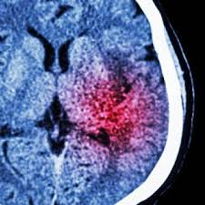
Healthcare in America: the Good, the Bad, and the Lovely
The BAD:
According to the Centers for Disease Control and Prevention (CDC) in 2015
stroke was the fifth leading cause of death in the United States. Those who
survive are classified among the highest and most serious long term disability
patients. According to the 2013 Population statistic Census, approximately
19.3% of the U.S. population lives in rural areas, many of which lack permanent
presence of an expert neurologist.
The GOOD:
Tele-Stroke improves the efficacy and efficiency of treatment of acute stroke in patients presenting to the emergency departments of rural hospitals by connecting with distant neurologist who are experts in the diagnosis and treatment of strokes.
Tele stroke provides enhancement of utilization of tPA and when tPA is managed, stroke patients experience a better quality of life, decreased rates of disability and improved rehabilitation.
The LOVELY:
A 40 year old female presented to a rural Emergency Department exhibiting stroke symptoms of speech difficulties, mental confusion, and facial weakness. The hospital had recently implemented a tele-stroke program and connected immediately with a board certified neurologist located hundreds of miles away. An examination took place along with scans of the brain and within minutes, a diagnosis of an ischemic stroke was made and the treatment recommendation was the administration of tPA. The treatment was so successful that following a few days of hospitalization, the patient was discharged symptom free and ordered to “go have a wonderful life!”

Slide 16
Healthcare in America: the Good, the Bad, and the Lovely
The BAD:
The regionalization of pediatric services has resulted in unequal access
to care, sometimes creating barriers to those living in underserved, rural
communities. These disparities to access contribute to inferior healthcare
outcomes among infants and children.
The GOOD:
Studies demonstrate the feasibility and efficiencies gained with models of care that use telemedicine. By providing pediatric and subspecialty care in more convenient settings such as local primary care offices and community hospitals, pediatric patients are more likely to receive care that adheres to evidence-based guidelines.
Models of care that use telemedicine have the potential to address pediatric specialists’ geographic misdistribution and address disparities in the quality of care delivered to children in underserved communities.
The LOVELY:
An elementary child with severe behavior problems in a rural SE Georgia school system was seen virtually by an Autism Specialist in Atlanta. Proper diagnosis and treatment resulted in a child who could now function at a high level, he ended up in the gifted program at his school.
A rural middle school child from a dysfunctional family had a severe staph infection in the lower leg causing great discomfort and inability to walk normally. The school nurse worked with the father to schedule a telemedicine visit with a pediatrician. As a result of the virtual visit, the child received proper treatment and according
to the physician, she was spared an amputation due to the severity of the infection.
http://www.nature.com/pr/journal/v79/n1-2/full/pr2015192a.html

Slide 17
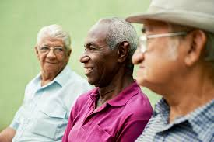
Healthcare in America: the Good, the Bad, and the Lovely
The BAD:
The aging of the baby boom generation could fuel a 75 percent increase in the number of Americans ages 65 and older requiring skilled nursing facility (SNF) care, to about 2.3 million in 2030 from 1.3 million in 2010.
Demand for elder care will also be fueled by a steep rise in the number of Americans living with Alzheimer’s disease, which could nearly triple by 2050 to 14 million, from 5 million in 2013
The GOOD:
SNFs, as well as other care settings throughout the care continuum, are investigating & implementing innovative ways to improve outcomes, reduce costs, and enhance the patient experience. Telehealth is a powerful tool to assist physicians with clinical assessment and accurate diagnosis from distant locations.
Behavioral health and mental health issues are prevalent in the SNF. Psychiatry is another type of specialty care that can be brought to the patient’s bedside using the telehealth concept.
With tele-psychiatry as the second-most-common use of telehealth (after stroke care), the incorporation of tele-psychiatry into SNFs elevates the standard of care and supports treating the whole patient.
The LOVELY:
A SNF resident suffering from depression and refusing to engage
in life had a virtual visit with a geriatric psychiatrist and received proper
treatment. As a result of the advanced care, she was able to overcome
the grip of depression and engage in activities of daily living again.
Middle of the night transports to rural EDs are avoided because
SNF medical directors are willing to provide telehealth consultations
to evaluate and treat non urgent issues.
http://www.prb.org/Publications/Media-Guides/2016/aging-unitedstates-fact-sheet.aspx

Slide 18
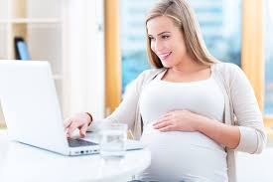
Healthcare in America: the Good, the Bad, and the Lovely
The BAD:
Women in rural communities with obstetrical complications, or medical conditions that
put them at risk of obstetrical complications, do not typically have access to see a
maternal-fetal medicine (MFM) specialist.
The GOOD:
Telemedicine gives women in underserved communities access to MFM specialists
eliminating the need to travel long distances.
Early interventions can help:
Prevent progression of obstetrical complications during pregnancy
Provide early life-saving measures for the mother and baby
Increase the likelihood of delivering a healthier baby
The LOVELY:
High Risk Pregnancy with twins seeing a local obstetrician in small town in south Georgia. Sonograms showing that one twin is out growing the other twin and the local doctor arranges for a telehealth MFM consultation. Mother sees a MFM specialist located over 200 miles north and a diagnosis of “twin to twin transfusion syndrome” is made. Mother immediately transported from a South Georgia to Miami, FL for surgery and the outcomes produced two healthy babies.

Slide 19
Healthcare in America: the Good, the Bad, and the Lovely
The BAD:
A 2016 study states that 81% of US Consumers are unsatisfied with their healthcare
experience. Consumers want more timely, more affordable, and more convenient access to quality
health care.
The GOOD:
Widespread dissatisfaction in healthcare creates openings for new players to further
disrupt the landscape.
Dissatisfaction opens the door for nontraditional, customer centric offerings in non
traditional settings like retail spaces and the world wide web.
Consumers, particularly younger ones , increasingly expect healthcare to work the way other digital markets work, with user-friendly interfaces, clearly defined pricing and a wide selection of product options designed to meet their needs.
The LOVELY:
A mother is putting her 3 year old to bed one evening and notices that the child is congested and breathing a little heavy. Even though it resembled the onset of a cold, the suddenness and symptoms made the mom uneasy. She recently heard that the local children’s hospital had launched a direct to consumer app “Connect with a Pediatrician 24/7” where you could video consult for a fee of $49. She decided to make the connection. Following the examination and collection of relevant data, the mom was instructed to immediately take the child to the closet ED. Through the virtual consultation, the pediatrician discovered that the child had eaten shrimp for the 1st time that evening and she was displaying anaphylactic reaction symptoms that, if left untreated, could lead to death. Wow! A baby saved because
of direct to consumer telehealth.
http://www.businesswire.com/news/home/20160308006233/en/81-Consumers-Unsatisfied-Healthcare-Experience-New-Study

Slide 20
Telehealth: the Good, the Bad, and the Lovely
Crossing the Telehealth Chasm
Barriers have challenged widespread telemedicine adoption by health care organizations for decades.
These barriers have been technological, financial, legal and challenges related to business strategy and human factors.
https://www.ncbi.nlm.nih.gov/pmc/articles/PMC3881125/

Slide 21
Crossing the Telehealth Chasm
By Addressing the Barriers
Technological
consistent broadband in many rural communities
data sharing between entities
funds to purchase hardware / software
Financial
proper reimbursement
ROI & Realistic Formulas (downstream revenue, cost savings-avoid penalties,
expansion of services)
Legal
telehealth friendly regulations
Business strategy
strategic vision
integrating of telehealth into other health services
organizational champions from administration to IT and everyone in between
willingness to collaborate with other entities resulting in silos of care
marketing of services within and without of the organization
staff training
Human Factors
interest and resistance by many in the medical community
interest and resistance by support staff
telehealth awareness in the community

Slide 22
What are the next steps?
To sum it up………

Slide 23
Find solutions to provide less costly, more efficient, and higher quality care.

Slide 24
Leverage Technology
To provide less costly, more efficient, and higher quality care.

Slide 25
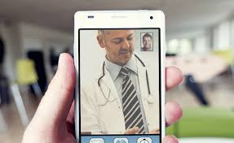
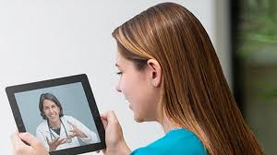
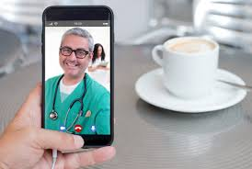
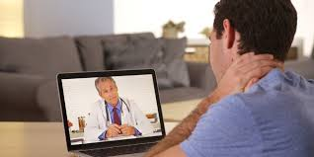
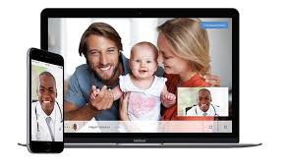
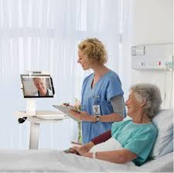
Healthcare in America
Embrace Telehealth
Leverage Technology

Slide 26
Telemedicine Billing
Bill Insurance
Modifiers
CMS & Medicaid
(POS 02)
GT – Live video
GQ – Store and forward
Contract with Providers
Direct-to-Consumer
Direct Bill patient
Medicaid
MCO
CMS (Medicare)
Private Payers

Slide 27
Resources:
Telehealth Resource Centers
www.telehealthresourcecenter.org
Center for Connected Health Policy
www.cchpca.org
Global / Georgia Partnership for Telehealth
www.gatelehealth.org

