Slide 1
A Guide to Successful Telehealth Implementation: The Evolution of TSIM™

Slide 2
A Guide to Successful Telehealth Implementation: The Evolution of TSIM™ © 2019 Medical University of South Carolina
Shawn Valenta RRT, MHA
Administrator of Telehealth
valentas@musc.edu

Slide 3
Acknowledgement
“This presentation was supported by the Health Resources and Services Administration (HRSA) of the U.S. Department of Health and Human Services (HHS) as part of the National Telehealth Center of Excellence Award (U66 RH31458-01-00). The contents are those of the author(s) and do not necessarily represent the official views of, nor an endorsement, by HRSA, HHS or the U.S. Government.”

Slide 4
Background on MUSC Telehealth
Complexities of telehealth service development, implementation, and sustainability
Creation and evolution of the TSIM™ framework

Slide 5
MUSC Health (Medical University of South Carolina)
Founded in 1824 in Charleston, SC
oldest medical school in the South
SC’s only comprehensive academic medical center
#1 ranked hospital in SC (US News & World Report)
NCI-designated Cancer Center
Level 1 Trauma Center
SC’s only nationally recognized children’s hospital

Slide 6
MUSC Center for Telehealth
2014
2017
2013
2019
2005-2009
Awarded ATA’s 2019 President’s Award for Transformation of Health Care Delivery (SCTA)
Designated by HRSA as a National Telehealth Center of Excellence (COE)
SCTA founded; headquartered at MUSC
State of SC telehealth investment; Center for Telehealth founded
Maternal Fetal Telemedicine, Telestroke, ICU, Telepsych
Notes:
>90% are non-MUSC sites

Slide 7
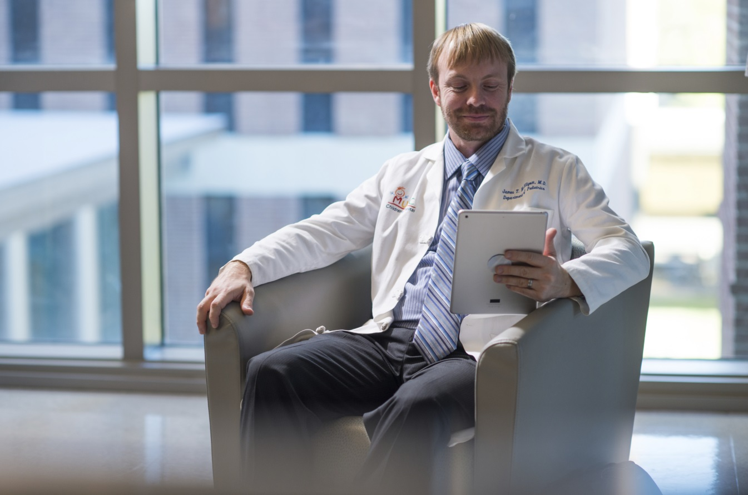
Center for Telehealth “Telehealth for efficient, effective care”
Assistance with:
Telehealth strategic planning
Telehealth service development
Contracting and legal issues
Credentialing
Equipment procurement and training
Compliance and billing issues
Workflow creation
External site relations
Executive Medical Director: Dr. Jimmy McElligott

Slide 8
Processes to be Navigated in Telehealth Service Development
Legal
Procurement
Provider engagement
Compliance
Reimbursement
Protocols
Workflows
Strategy
Training
Partnerships
Technology

Slide 9
Telehealth Implementation Challenges
Resource Intensive
Increasing Demand
Insufficient Planning & Best Practices
Assessment & Evaluation
Jennett, P., et al. (2003). A study of a rural community’s readiness for telehealth. J Telemedicine & Telecare, 9:259-263.
McIntosh, E. & Cairns, J. (1997). A framework for economic evaluation of telemedicine. J Telemedicine & Telecare, 3(3): 132-139.
Van Dyk, L. (2014). A review of the telehealth service implementation frameworks. International Journal of Public Health, 11: 1279-1298.

Slide 10
Current telehealth literature includes multiple & separate frameworks related to:
Diffusion
Readiness Assessment
Implementation
Evaluation
Broens, T.H., Vollenbroek-Hutten, M.M., Hermens, H.J., van Halteren, A.T., Nieuwenhuis, L.J. et al. (2007). Determinants of successful telemedicine implementations: a literature study. Journal of Telemedicine and Telecare, 13(6): 303-309.
Van Dyk, L. (2014). A review of the telehealth service implementation frameworks. International Journal of Public Health, 11: 1279-1298.
Notes:
Much of the literature focuses on readiness assessments and there is less guidance for the lifecycle of a telehealth program (Chips, Jennette, Legere, Parker-Oliver).

Slide 11
Sustainable Telemedicine: Designing and Building Infrastructure to Support a Comprehensive Telemedicine Practice (Mayo Clinic Experience)
Analysis of Challenges:
“Strategy…not clearly articulated”; priorities and scope not maintained
Services created from different practice areas resulted in variation, creating further challenges in providing operational support across the enterprise
Numerous stakeholders and competing priorities negatively impacted service development
Fragmented technology; no clear operational procedures
Beth L.H. Kreofsky, R. Nicole Blegen, Troy G. Lokken, Susan M. Kapraun, Matthew S. Bushman, and Bart M. Demaerschalk.Telemedicine and e-Health2018. http://doi.org/10.1089/tmj.2017.0291
Notes:
MUSC experienced these same challenges. Without Structure, the Complexity of Telehealth Can Breed Variation and Failure

Slide 12
Factors that Impact Telehealth Success
Perceptions
User-friendliness
Evaluation and evidence
Legislation
Policy and governance
Technology
Organizational structures
Change management
Economic feasibility
Societal impacts
“A holistic implementation approach is needed”
Van Dyk, L. (2014). A review of the telehealth service implementation frameworks. International Journal of Public Health, 11: 1279-1298.
Notes:
Implementation success rate disappointing
Successful pilots could not be sustained

Slide 13
A Need for Telehealth Structure at MUSC
Created a lot of pieces to service development (e.g. checklists)
Experienced a lot of growing pains
Started experiencing “concentration risk”
Needed a framework to put it all together (understand strengths and weaknesses)

Slide 14
Discovered ITIL (Information Technology Infrastructure Library)
Created by UK in 1980’s
Detailed best practices for IT service management
Aligns services with business needs
Used worldwide:
US Governments (States, Navy, Army)
Industry (Disney, Honda, Visa)
ITIL image retrieved from https://consultantsfactory.com

Slide 15
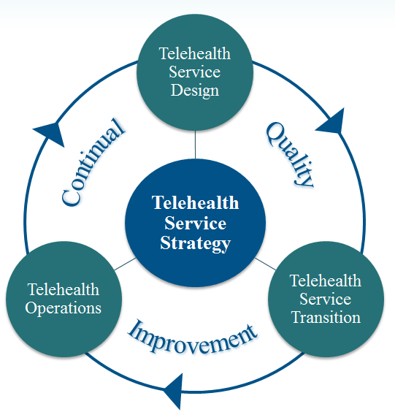
ITIL Inspired the Creation of TSIM™ (Telehealth Service Implementation Model)
“Telehealth is a clinical service delivered over an IT service”
Provided terminology and a standard framework
Highlighted strengths & weaknesses

Slide 16
TSIM™ (Telehealth Service Implementation Model)
Strategy
Ensures strategy is defined, maintained and then implemented
Design
Consistent approach to design and development
Transition
Period of testing through go-live
Operations
Supports responsive and stable services
Continual Quality Improvement
Aligns services to customers’ needs
Telehealth Service Strategy
Telehealth Service Design
Telehealth Service Transition
Telehealth Operations
Quality
Continual
Improvement

Slide 17
Telehealth Service Implementation Model (TSIM™)
Pipeline
of New Ideas
Operations
Design
Transition
Meet the needs of the customers!
Clinical
Protocols
Workflows
Technology
Equipment and Site Assessment
Procurement
Administrative
Legal
Credentialing - Regulatory
Outcomes
Performance Metrics
KPI Tracking
Billing - Compliance
Outcomes Reporting
Installation
Test Scripts
Strategy
Training
Equipment
Workflow
Mock Calls
Technology Pre-check
Dedicated Support
Go-Live
Dedicated IT Support
Dedicated Operational Support
Define scope of the service
Condition(s)
Location of the patient
Type of providers
What problem is being solved?

Slide 18
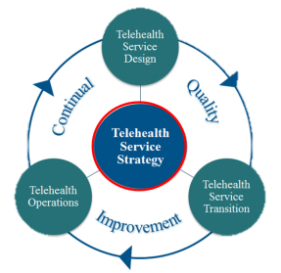
Strategy
Standardized Intake Form
Priority scoring and timeline projection
Defines scope of the service
Condition(s)
Location of patients
Type of providers
What problem is being solved?
Notes:
Ensures strategy is defined, maintained and then implemented
Providers are assigned to a dedicated coordinator (i.e. BRM) to help navigate steps in the framework

Slide 19
Thinking beyond “replicating care over distance” MUSC Center for Telehealth mission statement: “Telehealth for efficient, effective care”
Assess the impact on stakeholders:
Patients
Referring providers
Consulting providers
Payers
Health system (as a whole)
Prioritize services that:
Add efficiency to care teams
Add value to care over the continuum
Mitigate time and distance barriers to care
Notes:
Services cannot scale and sustain if a stakeholder is negatively impacted.

Slide 20
Standardized Scoring Tool
Support of implementation
Physician champion
Provider capacity
Strategic alignment
Potential impact
Quality
Cost
Access to care
Growth opportunity
Market size
Saturation
Demand

Slide 21
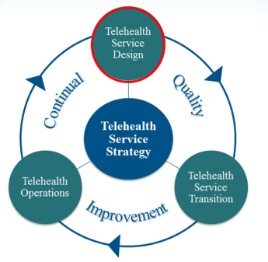
Design
Navigation through a common architecture of complex factors
Understand each “site of care” has different rules
Draft clinical and operational protocols
Customize test scripts
Identify KPI’s
Navigate compliance, legal, credentialing and EHR issues and processes
Notes:
The “build phase”

Slide 22
RACI matrix…through the common architecture
Responsible
Accountable
Consulted
Informed
The person completing the process/task
The person accountable that the process/task gets completed
A subject matter expert who is consulted about the process/task
A person(s) who needs to be aware that the task/process is being completed
Notes:
Outlines roles and responsibilities for each step through the common architecture in the framework

Slide 23
Transition
Operations
Design

Slide 24
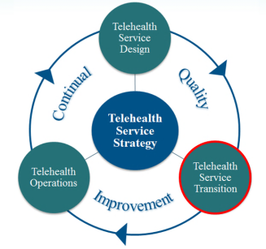
Transition
Movement from test to go-live
Training Roundtable –
Review of (1) service workflow and (2) roles and responsibilities
Official handoff to operations team
Mock calls
Alpha – internal testing
Beta – partner site testing
Pre Go-Live Brief
Strong communication of readiness!
Go-Live
Post Go-Live Debrief
Patient and provider feedback
Billing and documentation audit
Notes:
Go-live: Strong communication, Strong IT support, Strong operational support
Services stay in transition until predetermined volume is reached

Slide 25
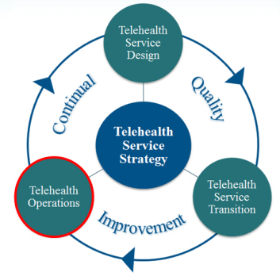
Operations
“We will deliver high quality, reliable services that continue to improve the patient and provider experience.”
Customer Success
Site Engagement
Service Quality Management
Service Training Management
Operational Technology Management
Infrastructure Reliability
Incident Management
Problem Management
Notes:
Ongoing assessment of Operational Effectiveness – utilization, patient experience, provider experience, quality (efficiency of care delivery), reliability

Slide 26
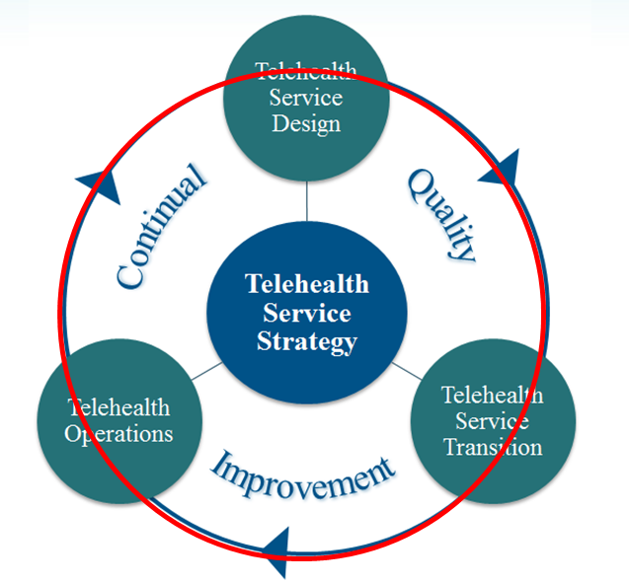
Continual Quality Improvement
Occurs throughout the lifecycle of the framework
Aims to align and realign the telehealth service to the ever-evolving customers’ needs
Striving for high-reliability
Examples of CQI:
Case presentations
Case reviews
In-depth provider interviews

Slide 27
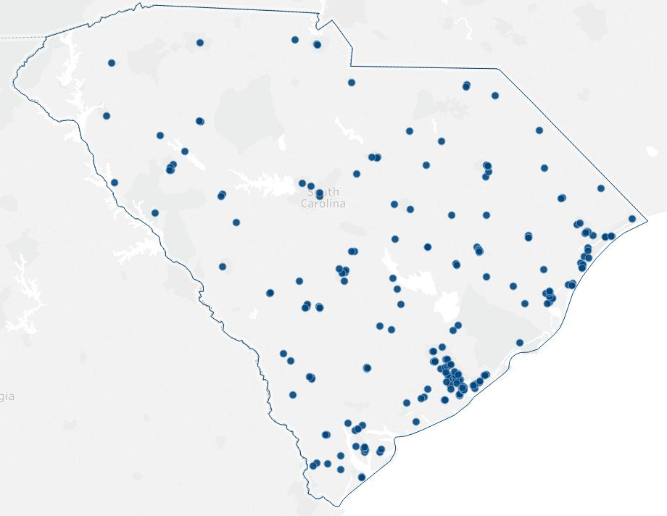
MUSC Telehealth - Connected Sites
MUSC telehealth breadth & depth:
80+ unique services
~300 sites
Hospitals, community clinics, schools, SNFs, jails
>90% are non-MUSC sites

Slide 28
Volume of MUSC Telehealth Interactions

Slide 29
Evaluating the TSIM™ Framework
2. Focus Groups/KI’s
3. Surveys
1. Implementation Tracking Log
Mixed methods approach and data triangulation:
Services implemented
Time to key milestones
Fidelity to the service
Telehealth uptake
Program fidelity
Uptake process
Sustainability capacity
Team engagement
Sustainability Capacity

Slide 30
Summation
Telehealth journey is complex
Success is achievable
Structured implementation framework is major catalyst

Slide 31
A Guide to Successful Telehealth Implementation: The Evolution of TSIM™ © 2019 Medical University of South Carolina
Shawn Valenta RRT, MHA
Administrator of Telehealth
valentas@musc.edu

